Slide 1
Model Calculation of Two-dimensional Raman-infrared Spectroscopies
2021/12/10
D2 Hideaki Takahashi
Notes:
このようなタイトルで発表～

Slide 2
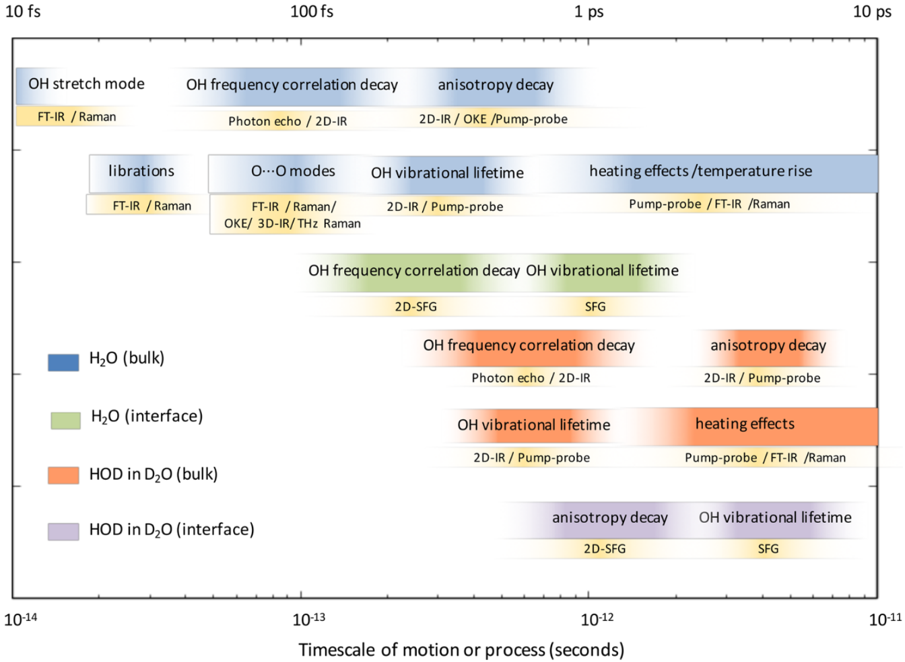
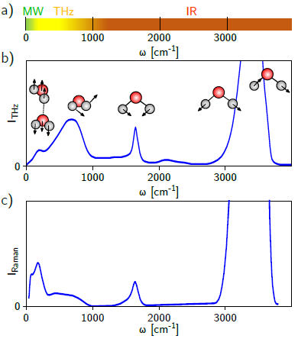
Timescale of vibrational modes of molecules
F. Perakis et. al., Chem. Rev. 116, 7590 (2016).
D. Sidler, Ph.D. Thesis (2020).

Slide 3
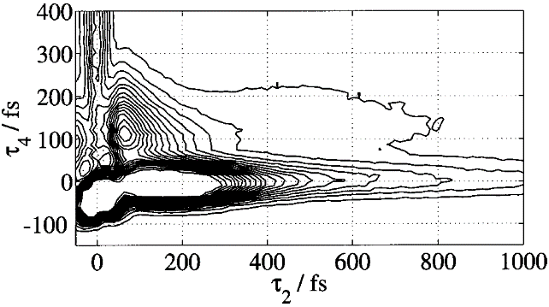
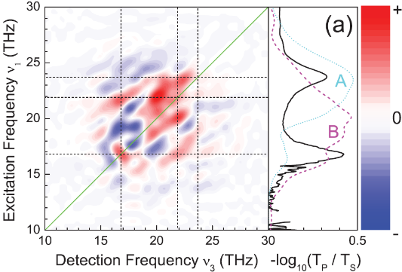
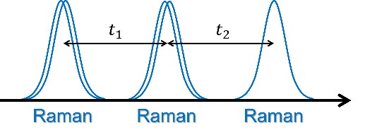
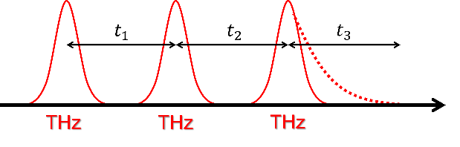
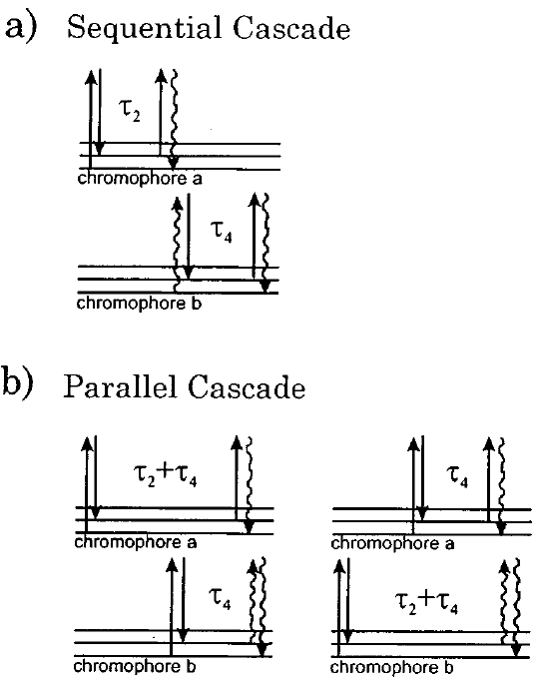
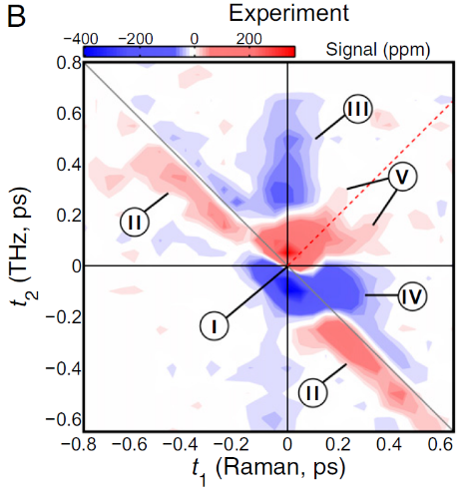
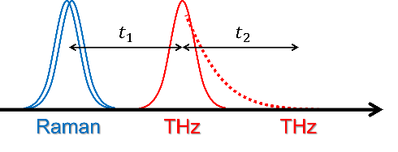
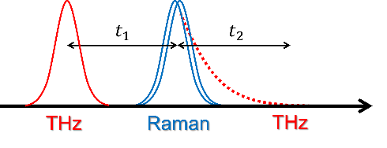
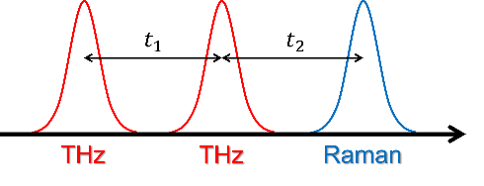
2D-Raman-THz
P. Hamm and J. Savolainen, J. Chem. Phys. 136, 094516 (2012).
M. Cho, J. Chem. Phys. 111, 4140 (1999).
2D Spectroscopies in the low-frequency range
・2D-Raman ⇒ Cascading problem
・2D-THz ⇒ Low pulse energy
D. A. Blank et. al., J. Chem. Phys. 113, 771 (2000).
W. Kuehn et. al., Phys. Rev. Lett 107, 067401 (2011).
・2D-Raman-THz
Circumvent these problems
D. A. Blank et. al., J. Chem. Phys. 111, 3105 (1999).
J. Savolainen et. al., Proc. Natl. Acad. Sci. U. S. A. 110, 20402 (2013).

Slide 4
2D-Raman-IR
P. Hamm and J. Savolainen, J. Chem. Phys. 136, 094516 (2012).
H. Ito and Y. Tanimura, J. Chem. Phys. 144, 074201 (2016).
・Investigate a coupling between inter- and intra-molecular vibrational modes
・To cover a wide range of frequencies
⇒ Raman pulse + IR pulse
Two-dimensional spectroscopies of vibrational modes
2D-Raman-IR
2D-Raman-THz
2D-IR
Intramolecular modes
Wavenumber
Intermolecular modes

Slide 5
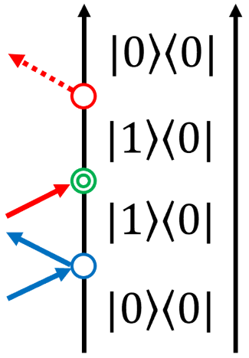
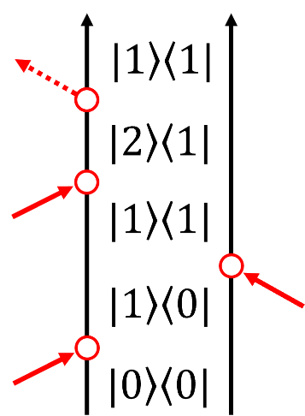
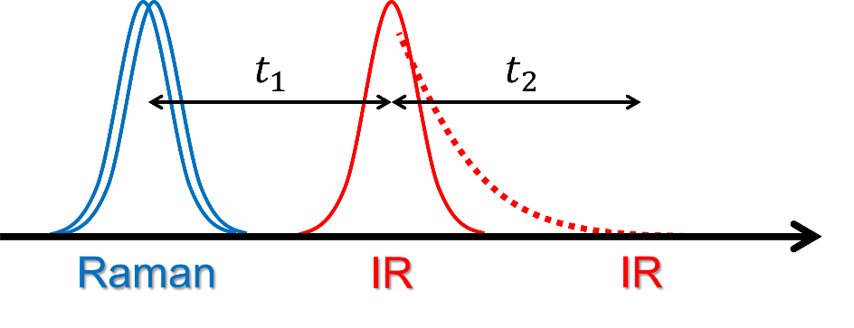
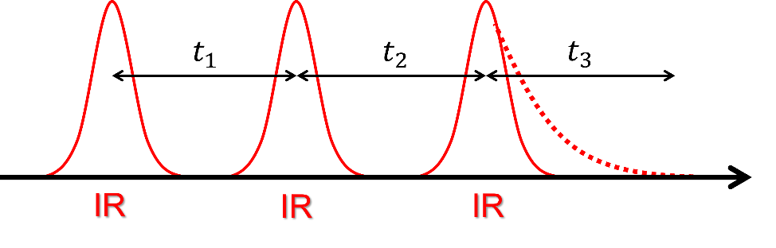
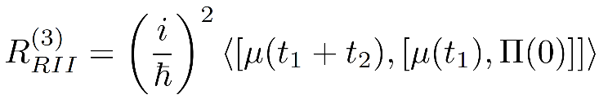
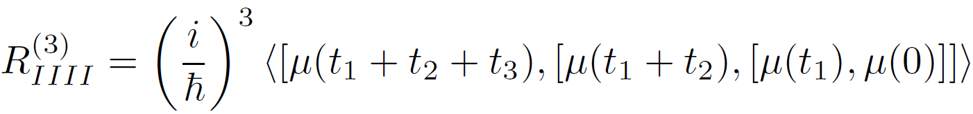
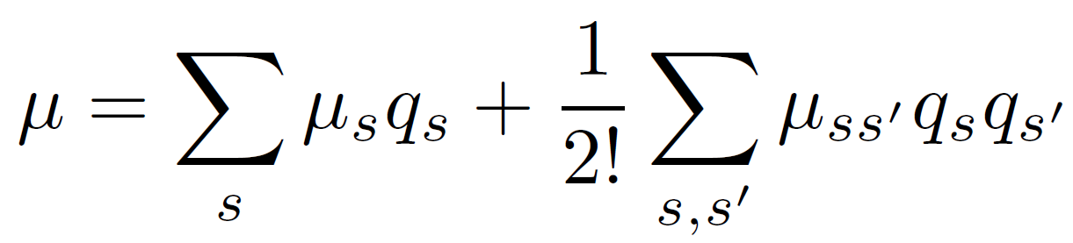
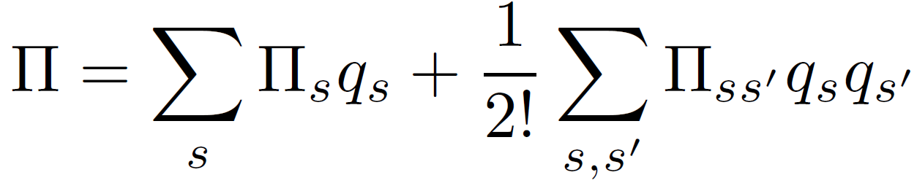
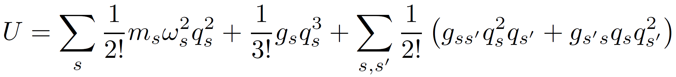
2D-Raman-IR
P. Hamm and J. Savolainen, J. Chem. Phys. 136, 094516 (2012).
H. Ito and Y. Tanimura, J. Chem. Phys. 144, 074201 (2016).
ex) Raman-IR-IR
cf. 2D-IR
⇒ Nonlinearity (NL) and Anharmonicity (AH) contribute to spectral peaks
Dipole
Polarization
Potential
Nonlinearity
Nonlinearity
Anharmonicity

Slide 6
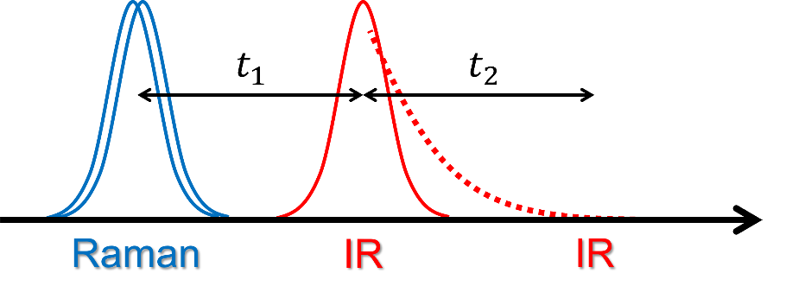
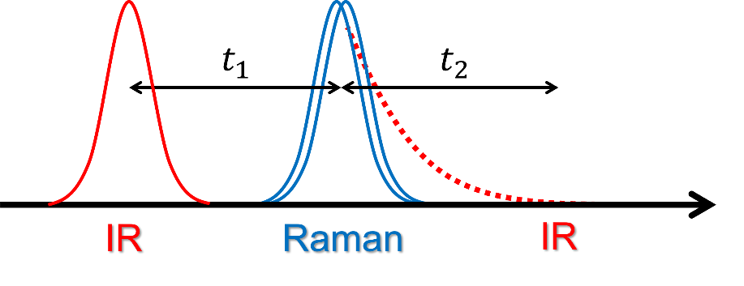
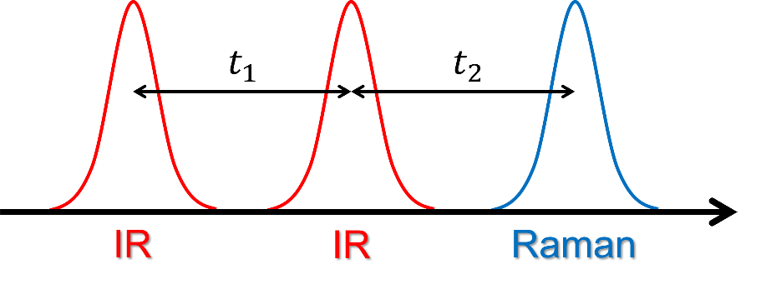
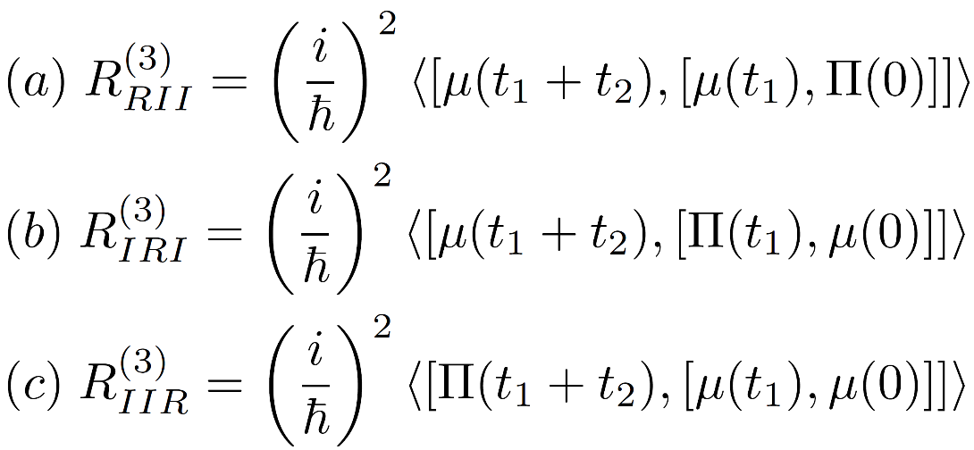
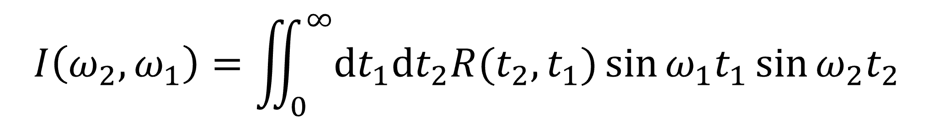
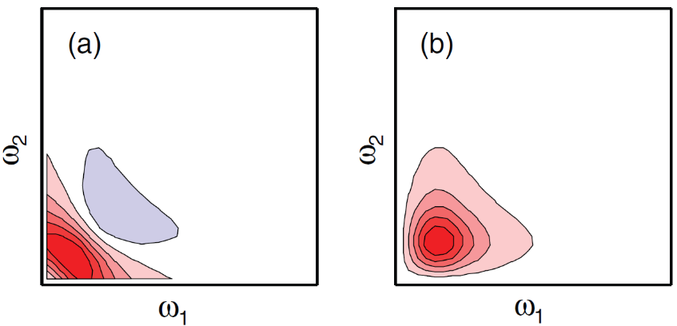
2D-Raman-IR
P. Hamm and J. Savolainen, J. Chem. Phys. 136, 094516 (2012).
H. Ito and Y. Tanimura, J. Chem. Phys. 144, 074201 (2016).
(a) Raman-IR-IR
(b) IR-Raman-IR
(c) IR-IR-Raman
Response Function
Spectrum
2D-sine-FT

Slide 7
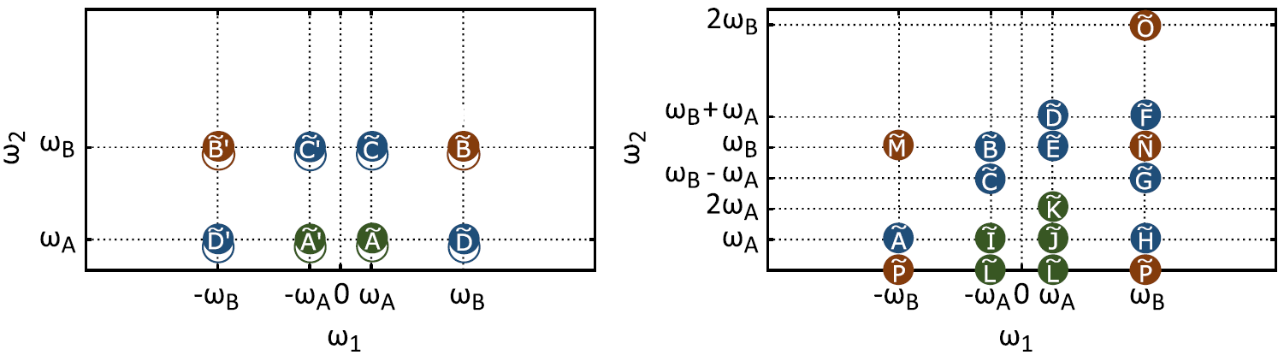
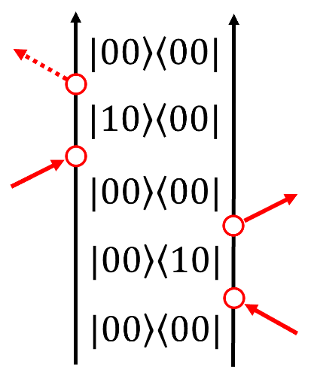
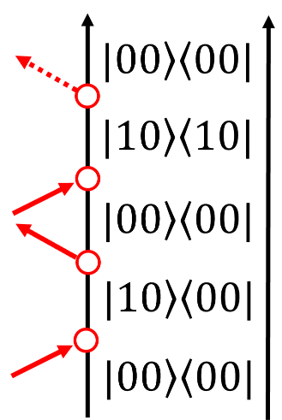
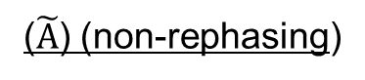
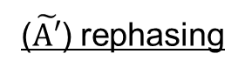
Complexity of 2D-Raman-IR spectrum
2D-IR
2D-Raman-IR
symmetry
ex)
($\tilde{A′}$) rephasing
($\tilde{A}$) (non-rephasing)
・asymmetric peaks
・overtones (Fermi resonance)
⇒ difficult to disentangle
D. Sidler and P. Hamm, J. Chem. Phys. 153, 044502 (2020).

Slide 8
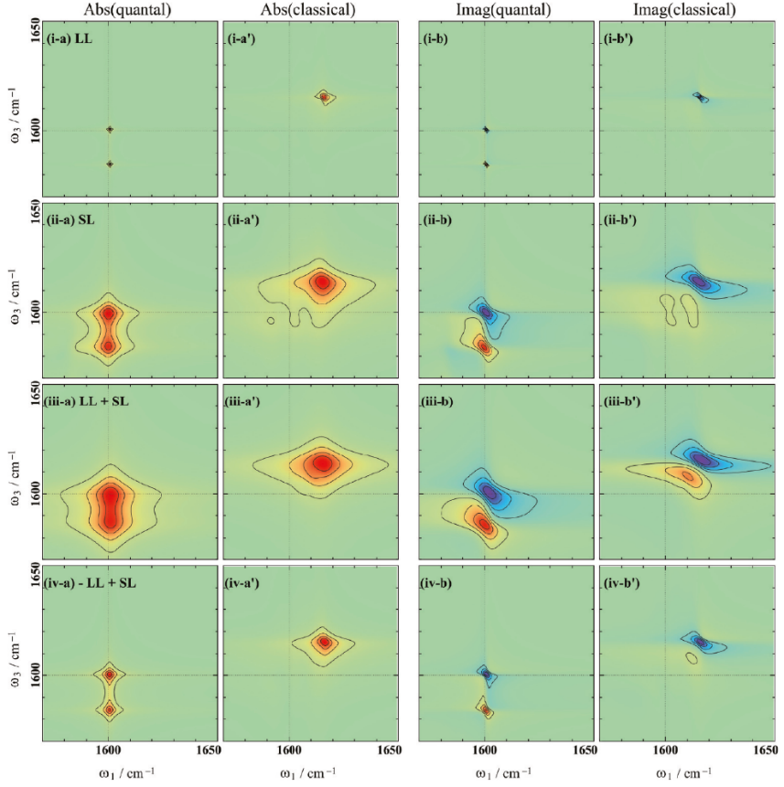
Theoretical problem and purpose
Both MD and model calculations have been performed only in the classical regime ⇒ predict spectra correctly taking quantum effects into account
2D-IR spectra of the morse potential system
1) Nonlocality of potential
2) Non-Markovian effect
Quantum effect is dominant in high frequency modes
A. Sakurai and Y. Tanimura, J. Phys. Chem. A 115, 4009 (2011).

Slide 9
Today’s topic
*Only one mode case
① Spectral features of NL and AH
② Effect of dissipation
③ Quantum effects

Slide 10
Simulation details
・quantum: HEOM (eigenstate representation)
classical: CHFPE
・Calculate 2D-Raman-IR spectra of one vibrational mode (neglect a mode-mode coupling)
・Temperature T=300K
① Spectral features of NL and AH
② Effect of dissipation
③ Quantum effects

Slide 11
Summary
・Calculate 2D-Raman-IR spectra of a vibrational mode
・Demonstrate the features of 2D-Raman-IR spectroscopies
・Future work ・Calculate 2D-spactra of mode-mode couplings (in progress)
・Apply to liquid water (in progress)
・Design four-body correlation spectroscopies

Slide 12
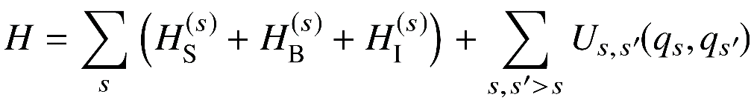
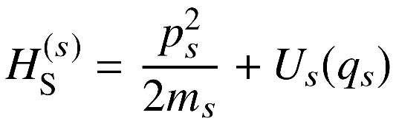
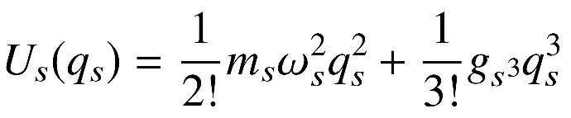
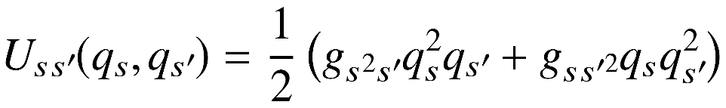
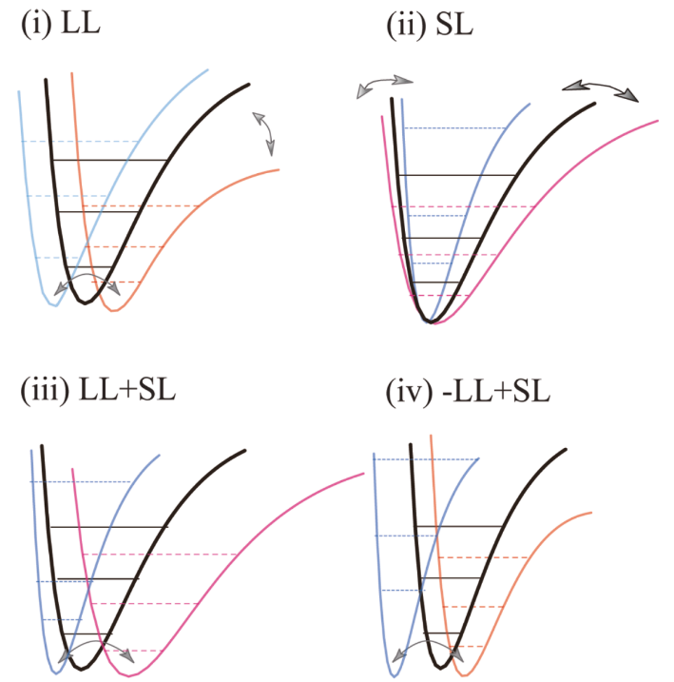
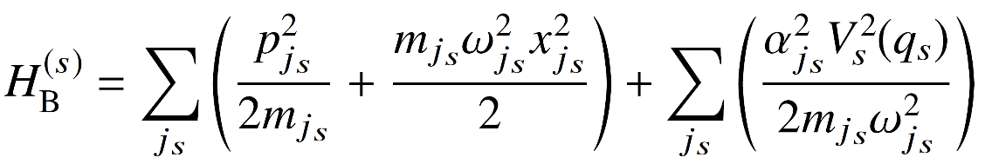
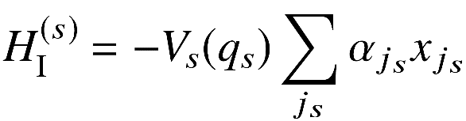
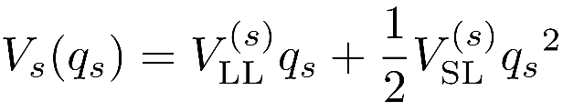
Model Hamiltonian
Total Hamiltonian
Hamiltonian of eachl mode
potential
Coupling between modes
Bath Hamitonian
System-bath coupling
A. Sakurai and Y. Tanimura, J. Phys. Chem. A 115, 4009 (2011).

Slide 13
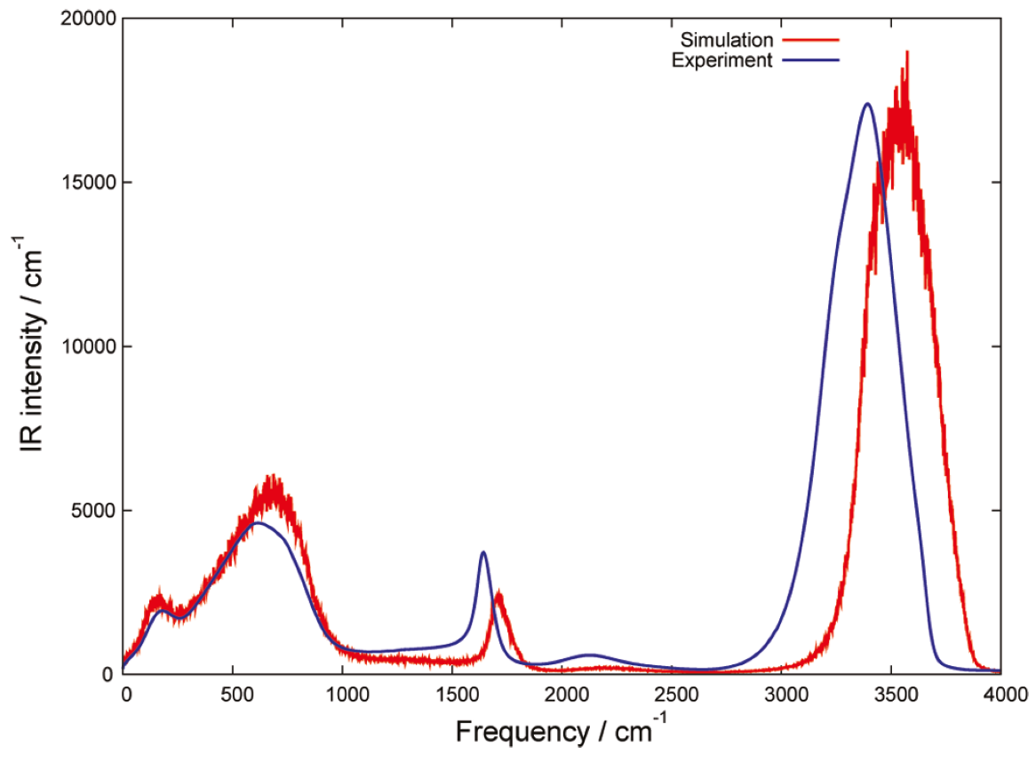
Intramolecular and intermolecular vibrational modes of liquid water
IR spectrum of liquid water
Vibrational modes
① OH stretching
② OH bending
③ Libration
④ HB translation
①
intramolecular
intermolecular
③
②
④
T. Hasegawa and Y. Tanimura, J. Phys. Chem. B 115, 5545 (2011).
Vibrational modes ⇒ Brownian oscillators + Environments

Slide 14
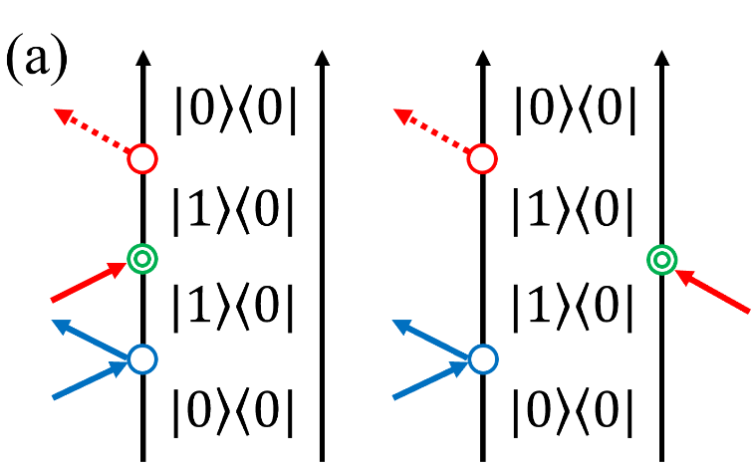
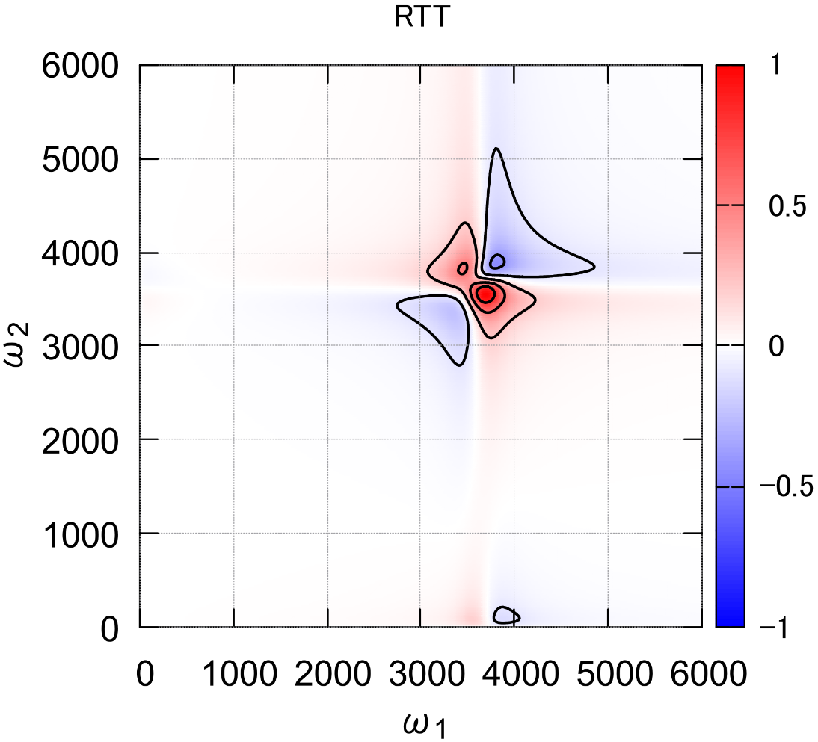
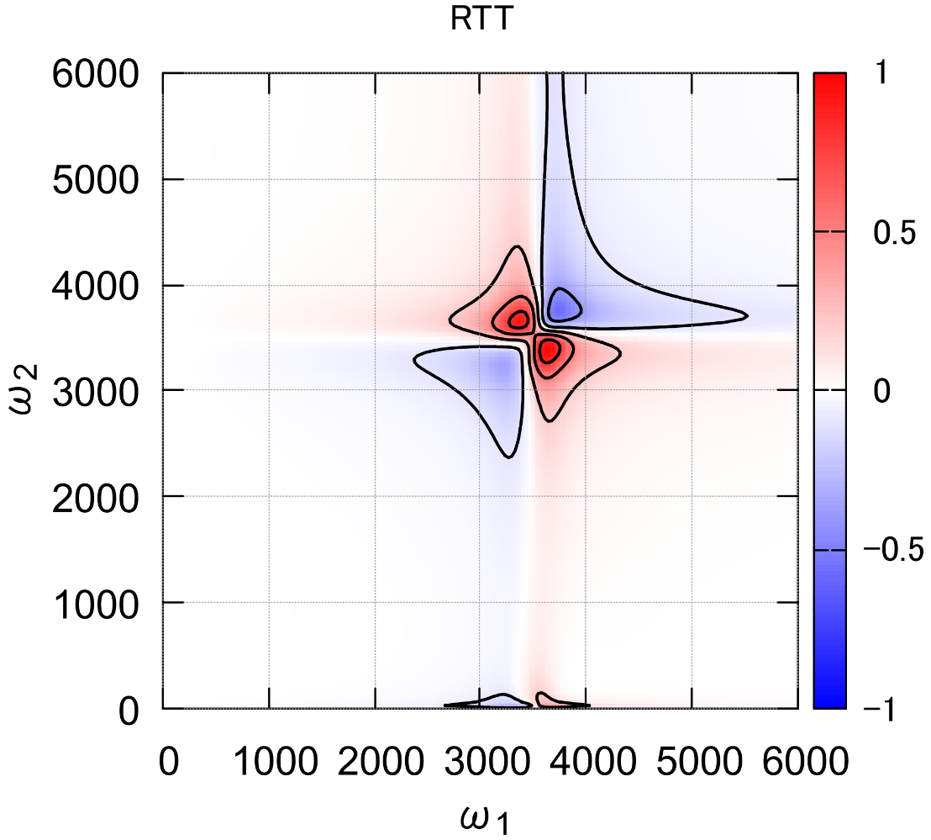
OH stretching
RII spectrum
IRI, IIR: almost the same profile ⇒ strong AH
quantum
classical
(a)
(a)
(b)
(b’)
(b)

Slide 15
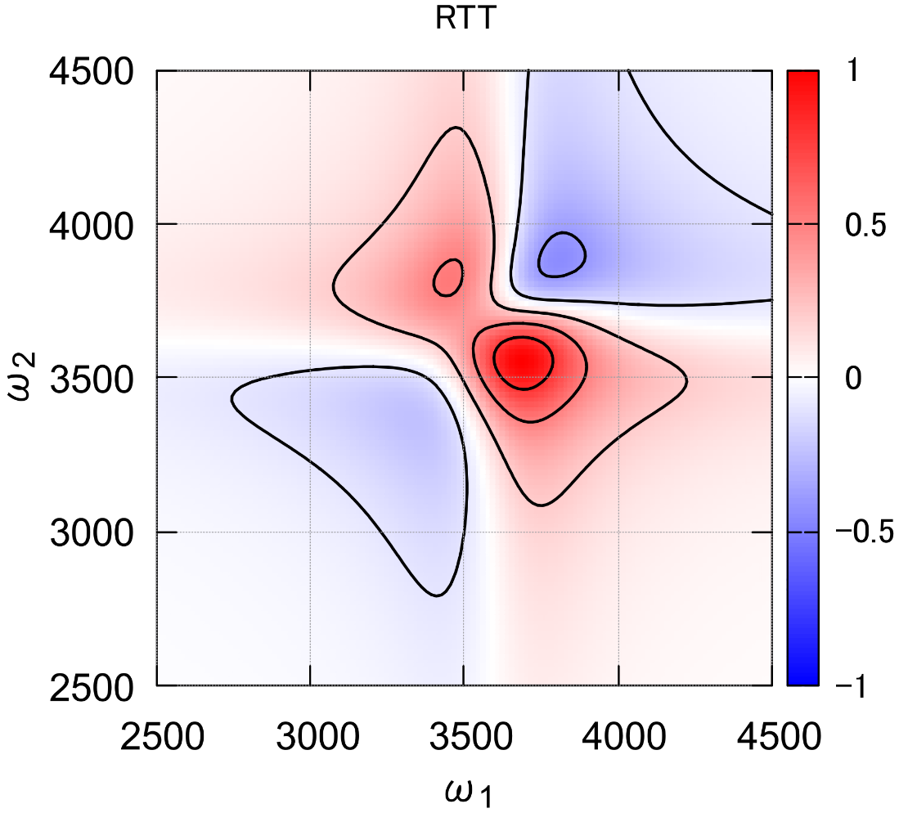
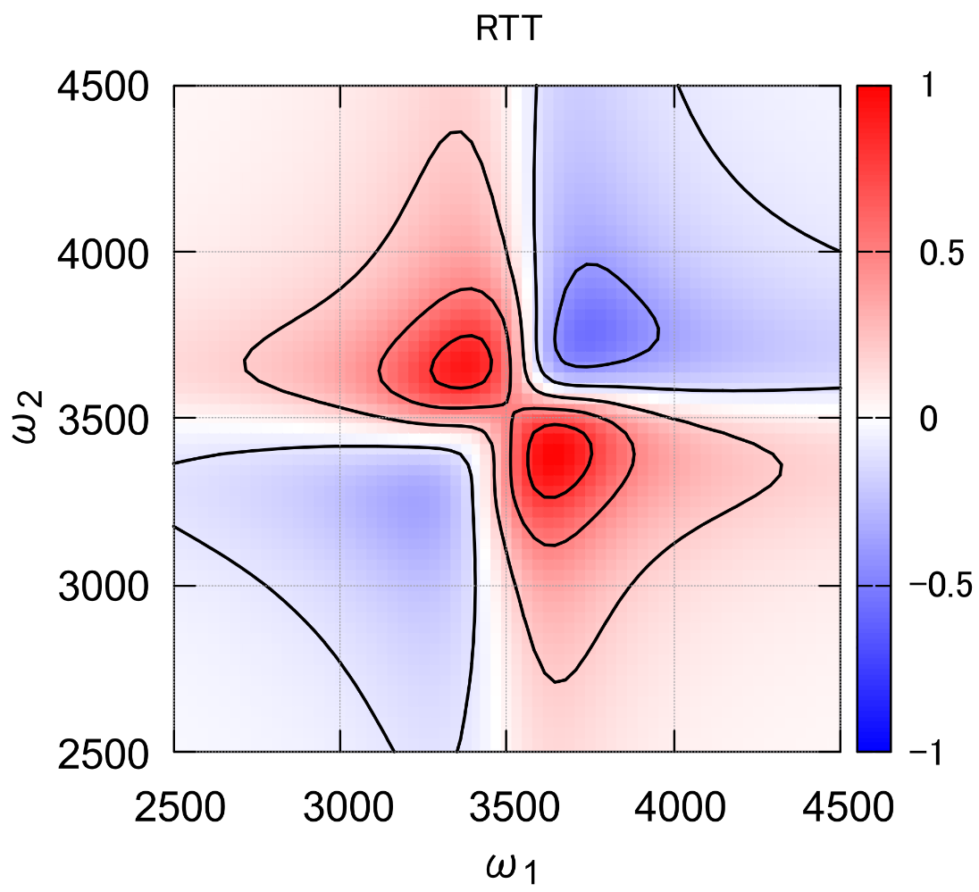
OH stretching
RII spectrum
IRI, IIR: almost the same profile ⇒ strong AH
quantum
classical
(a)
(a)

Slide 16
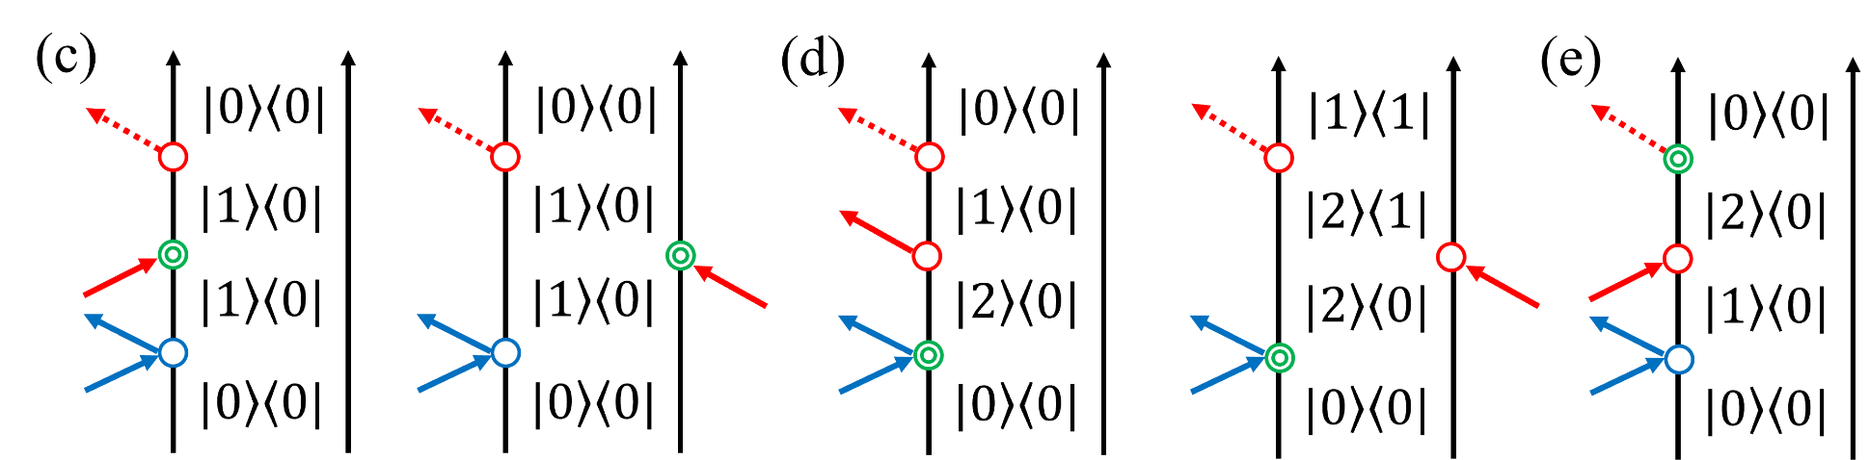
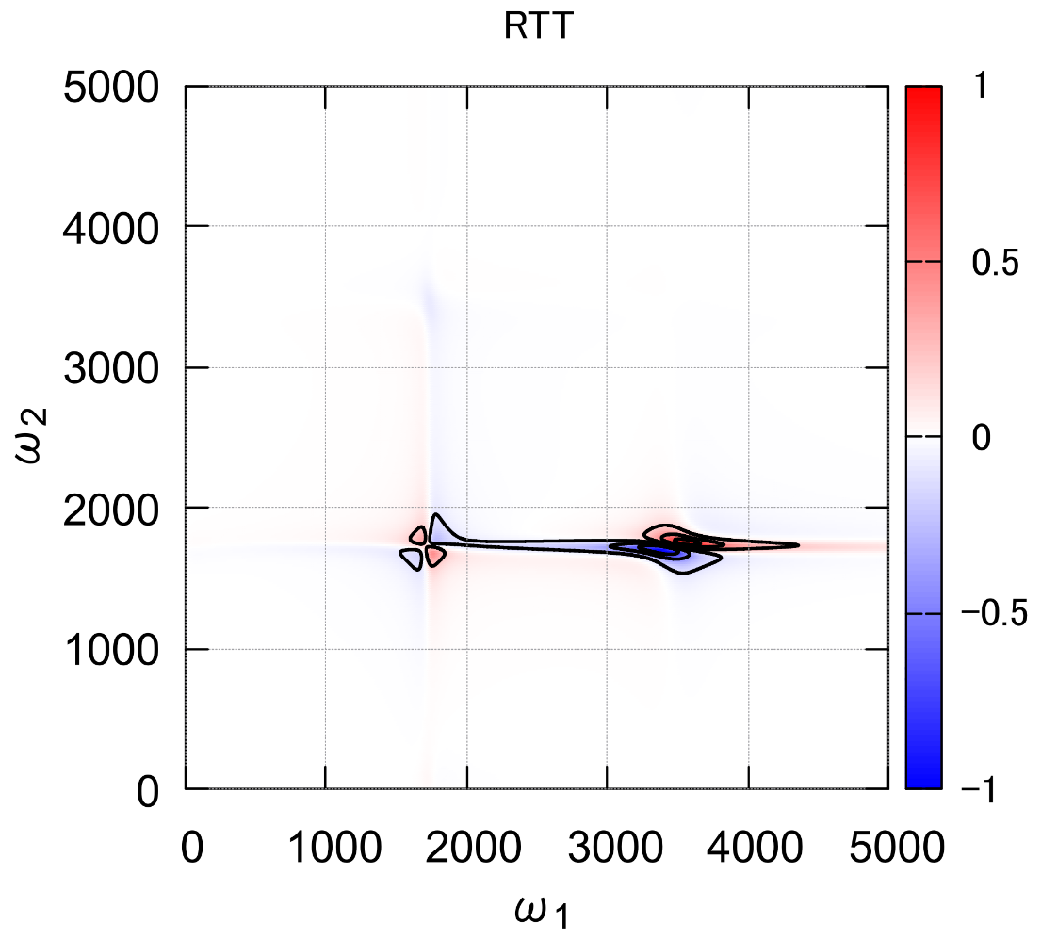
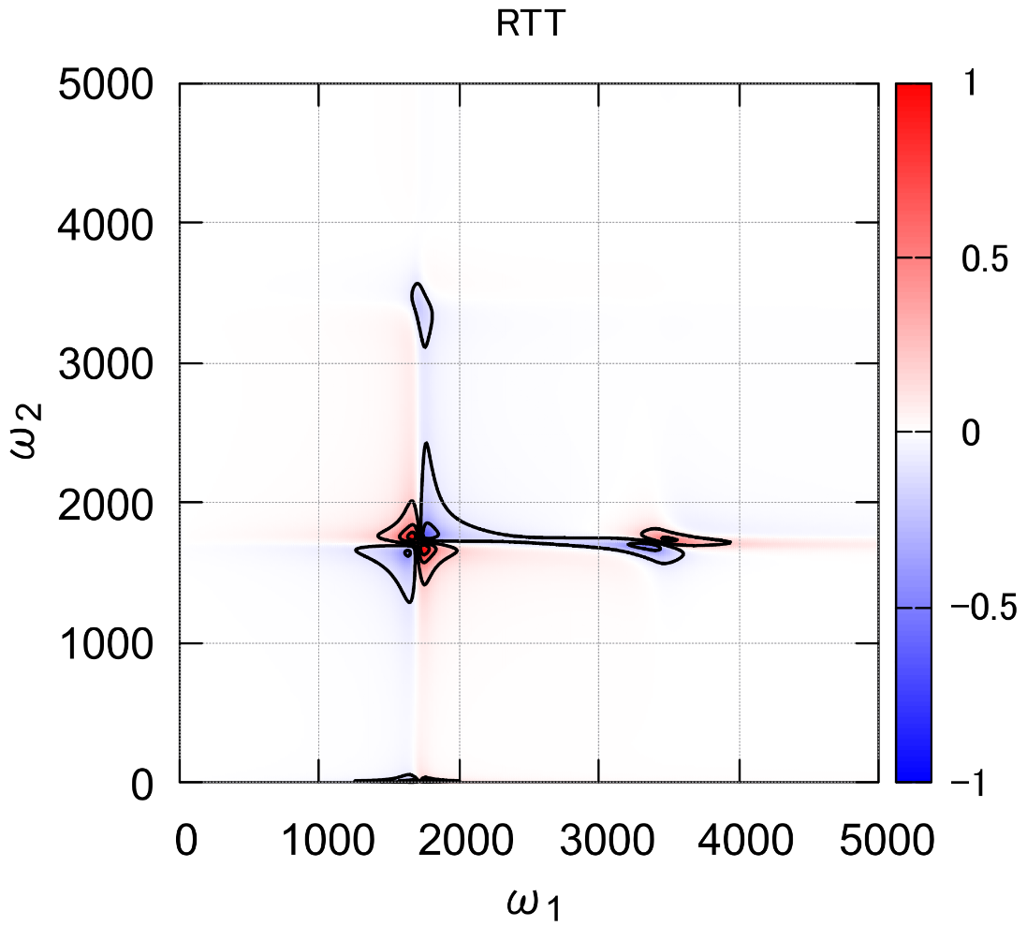
HOH bending
RII spectrum
quantum
classical
(e)
(c)
(d)
(c)
(d)

Slide 17
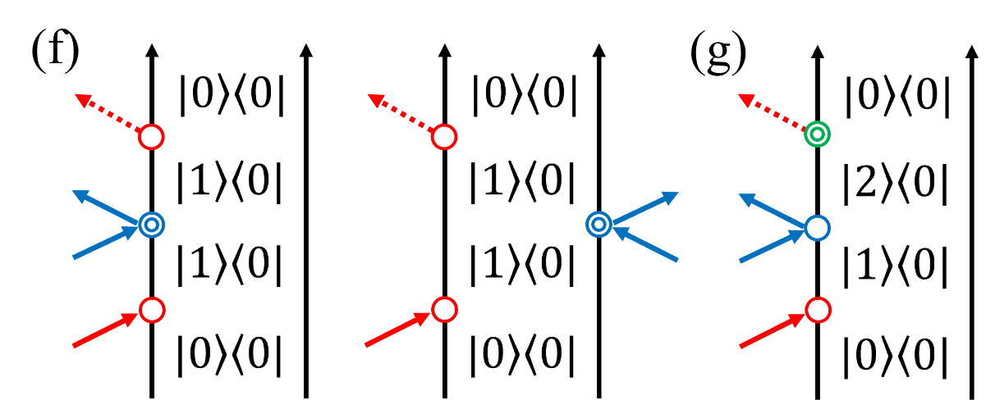


HOH bending
IRI spectrum
quantum
classical
(g)
(f)
(f)

Slide 18



HOH bending
IIR spectrum
quantum
classical
(h)
(h)

Slide 19


2D-Raman-IR
P. Hamm and J. Savolainen, J. Chem. Phys. 136, 094516 (2012).
H. Ito and Y. Tanimura, J. Chem. Phys. 144, 074201 (2016).
・To cover a wide range of frequencies (from inter- to intra-molecular modes)
⇒ Raman pulse + IR pulse
ex) Raman-IR-IR
cf. 2D-IR
⇒ NL and AH contribute to spectral peaks
Dipole
Polarization
Potential
Nonlinearity
Nonlinearity
Anharmonicity

